Slide 1
QF602: Derivatives
Lecture 7:
More on Option Pricings

Slide 2
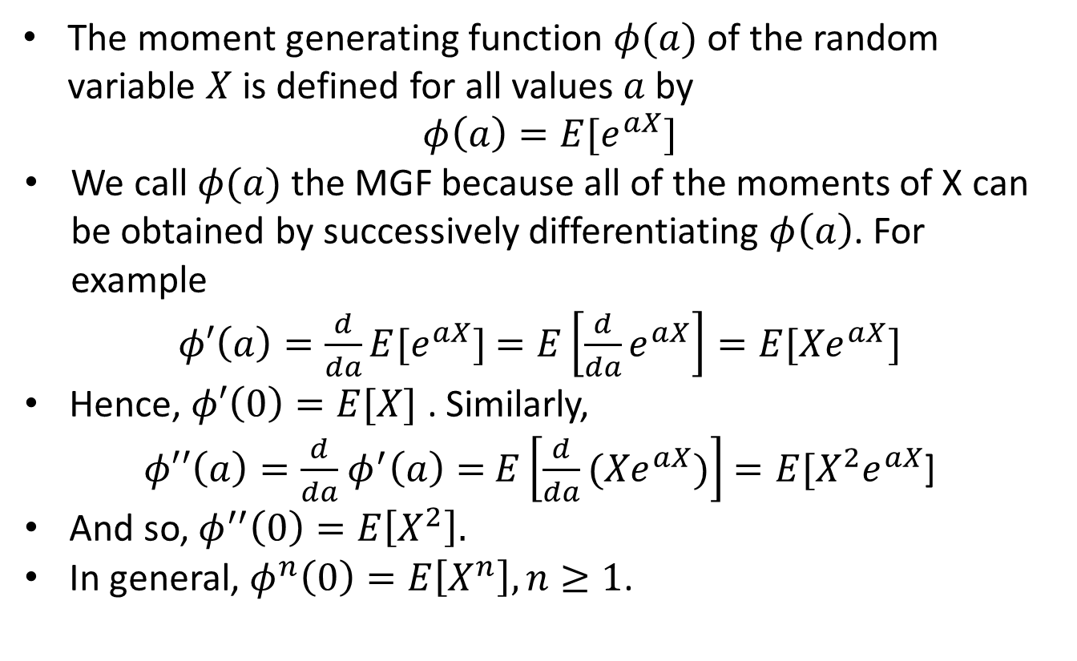
Moment Generating Function
The moment generating function $φ(a)$of the random variable $X$ is defined for all values $a$ by
$$φ\left(a\right)=E[e^{aX}]$$
We call $φ(a)$the MGF because all of the moments of X can be obtained by successively differentiating $φ\left(a\right)$. For example
$φ′\left(a\right)=\frac{d}{da}E[e^{aX}]$ $=E\left[\frac{d}{da}e^{aX}\right]=E[{Xe}^{aX}]$
Hence, $φ′\left(0\right)=E[X]$ . Similarly,
$φ′′\left(a\right)=\frac{d}{da}$ $φ^{′}\left(a\right)=$ $E\left[\frac{d}{da}{(Xe}^{aX})\right]$ $=E[{X^{2}e}^{aX}$]
And so, $φ^{′′}\left(0\right)=E\left[X^{2}\right].$
In general, $φ^{n}\left(0\right)=E\left[X^{n}\right], n≥1$.

Slide 3
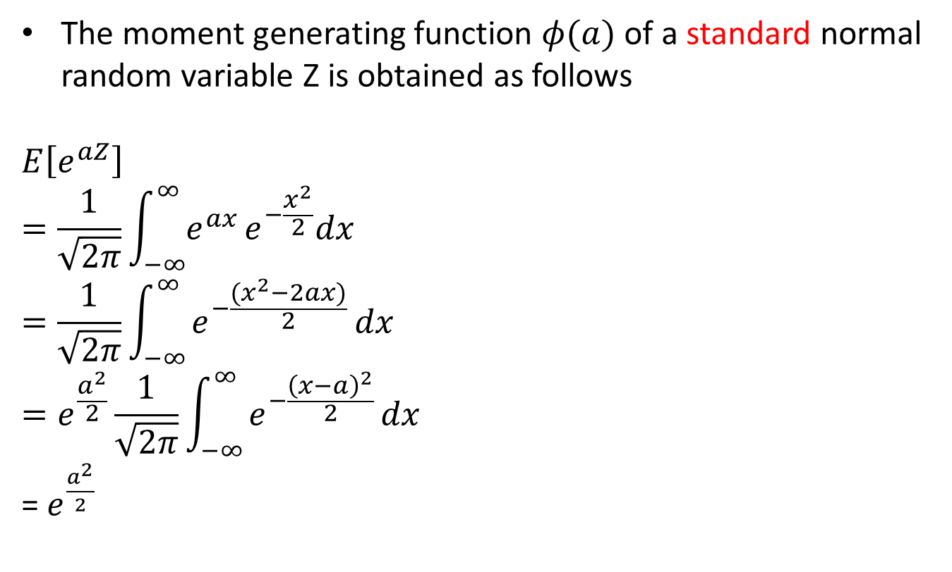
Normal Distribution
The moment generating function $φ(a)$of a standard normal random variable Z is obtained as follows
$$E\left[e^{aZ}\right]$$
$$=\frac{1}{\sqrt{2π}}\int_{−∞}^{∞}{e^{ax}}e^{−\frac{x^{2}}{2}}dx$$
$$=\frac{1}{\sqrt{2π}}\int_{−∞}^{∞}{e^{−\frac{{(x}^{2}−2ax)}{2}}}dx$$
$$=e^{\frac{a^{2}}{2}}\frac{1}{\sqrt{2π}}\int_{−∞}^{∞}{e^{−\frac{{\left(x−a\right)}^{2}}{2}}}dx$$
= $e^{\frac{a^{2}}{2}}$

Slide 4
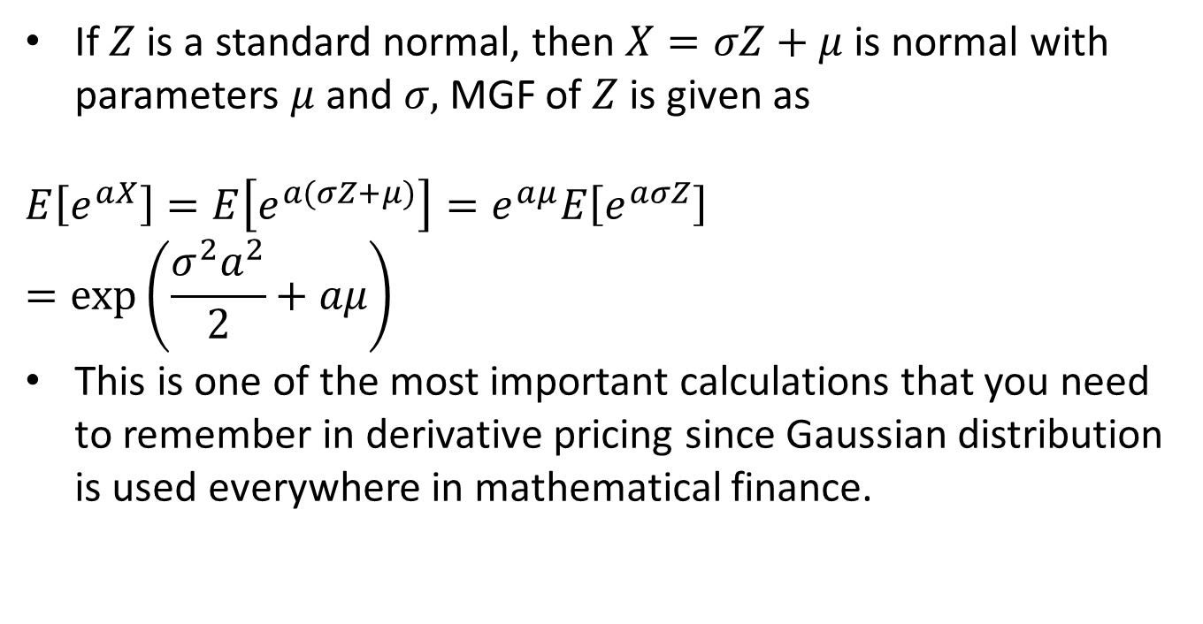
Normal Distribution
If $Z$ is a standard normal, then $X=σZ+μ$ is normal with parameters $μ$ and $σ,$ MGF of $Z$ is given as
$$E\left[e^{aX}\right]=E\left[e^{a(σZ+μ)}\right]=e^{aμ}E\left[e^{aσZ}\right]$$
$$=\exp\left(\frac{σ^{2}a^{2}}{2}+aμ\right)$$
This is one of the most important calculations that you need to remember in derivative pricing since Gaussian distribution is used everywhere in mathematical finance.

Slide 5
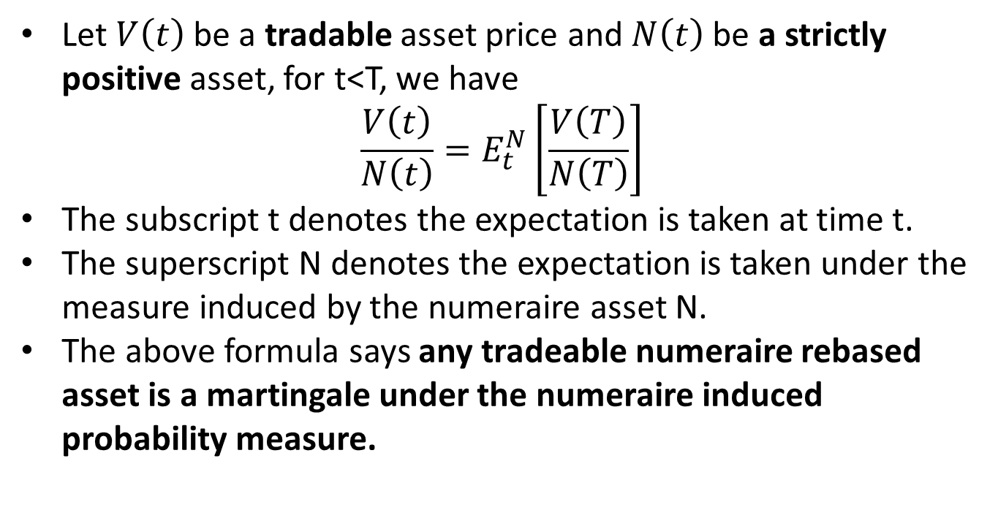
Martingale pricing
Let $V\left(t\right)$ be a tradable asset price and $N\left(t\right)$ be a strictly positive asset, for t<T, we have
$$\frac{V\left(t\right)}{N\left(t\right)}=E_{t}^{N}\left[\frac{V\left(T\right)}{N\left(T\right)}\right]$$
The subscript t denotes the expectation is taken at time t.
The superscript N denotes the expectation is taken under the measure induced by the numeraire asset N.
The above formula says any tradeable numeraire rebased asset is a martingale under the numeraire induced probability measure.

Slide 6
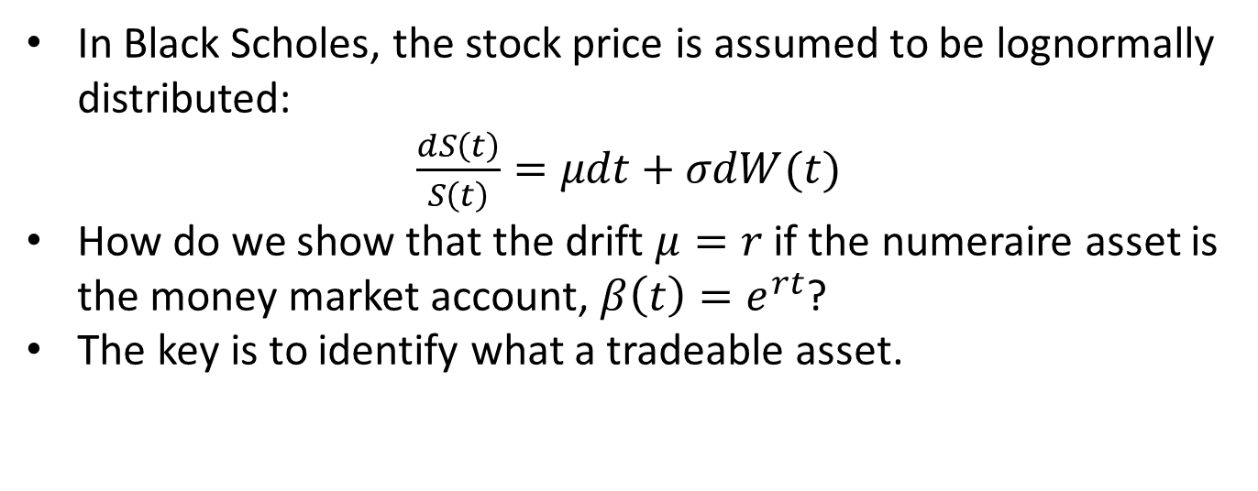
Why the risk neutral drift is r?
In Black Scholes, the stock price is assumed to be lognormally distributed:
$\frac{dS\left(t\right)}{S\left(t\right)}=μdt+σdW(t)$
How do we show that the drift $μ=r$ if the numeraire asset is the money market account, $β\left(t\right)=e^{rt}$?
The key is to identify what a tradeable asset.

Slide 7
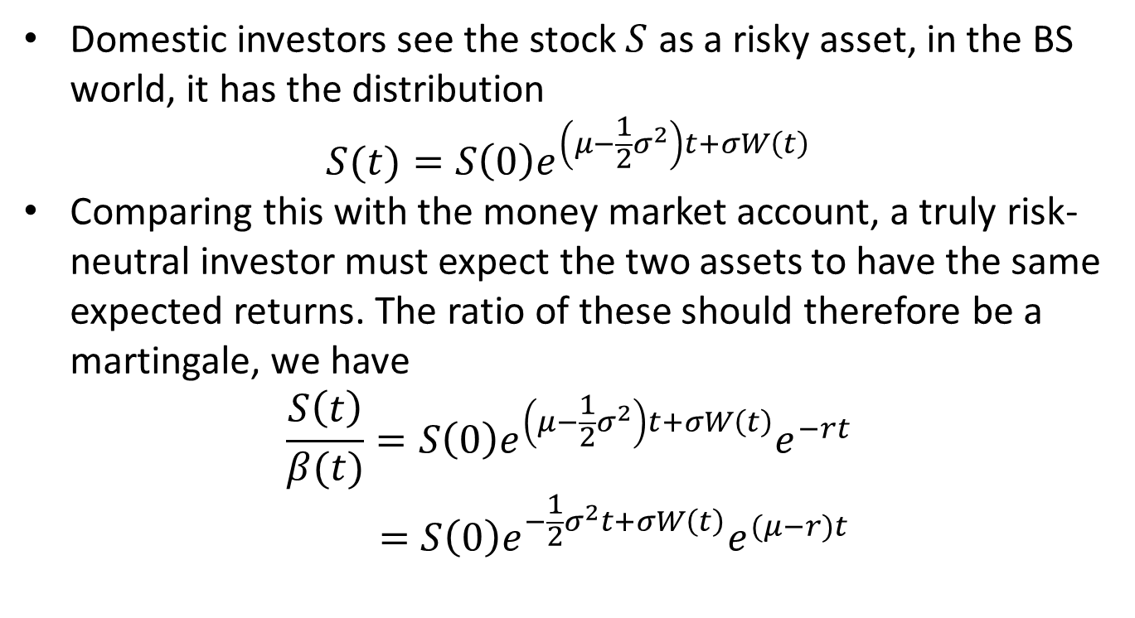
Why the risk neutral drift is r?
Domestic investors see the stock $S$ as a risky asset, in the BS world, it has the distribution
$$S(t)=S\left(0\right)e^{\left(μ−\frac{1}{2}σ^{2}\right)t+σW\left(t\right)}$$
Comparing this with the money market account, a truly risk-neutral investor must expect the two assets to have the same expected returns. The ratio of these should therefore be a martingale, we have
$$\frac{S\left(t\right)}{β(t)}=S\left(0\right)e^{\left(μ−\frac{1}{2}σ^{2}\right)t+σW\left(t\right)}e^{−rt}$$
$$=S\left(0\right)e^{−\frac{1}{2}σ^{2}t+σW\left(t\right)}e^{(μ−r)t}$$

Slide 8
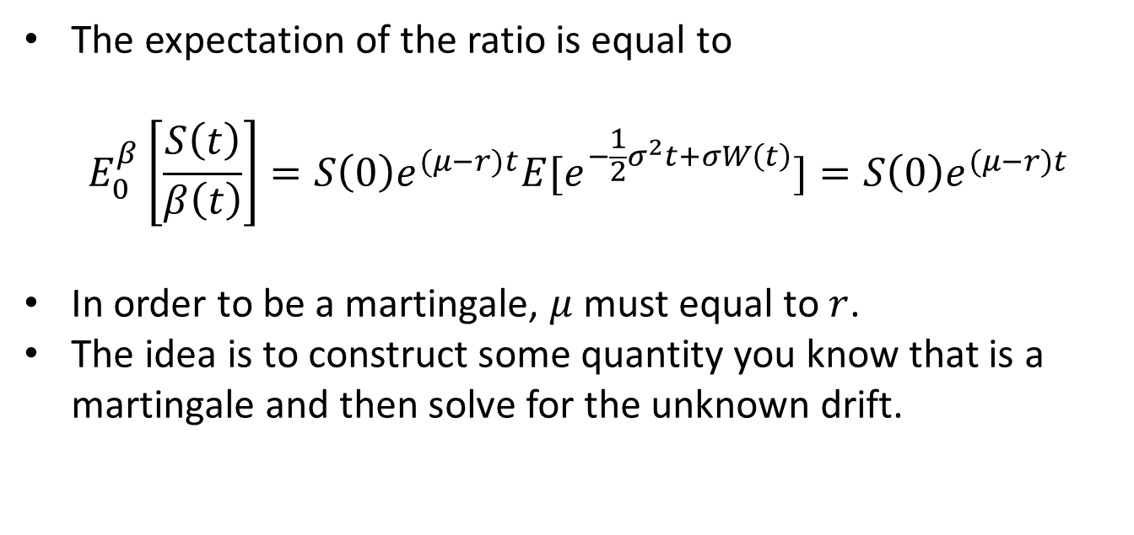
Why the risk neutral drift is r?
The expectation of the ratio is equal to
$$E_{0}^{β}\left[\frac{S\left(t\right)}{β\left(t\right)}\right]=S\left(0\right){e^{(μ−r)t}E[e}^{−\frac{1}{2}σ^{2}t+σW\left(t\right)}]=S\left(0\right)e^{(μ−r)t}$$
In order to be a martingale, $μ$ must equal to $r$.
The idea is to construct some quantity you know that is a martingale and then solve for the unknown drift.

Slide 9
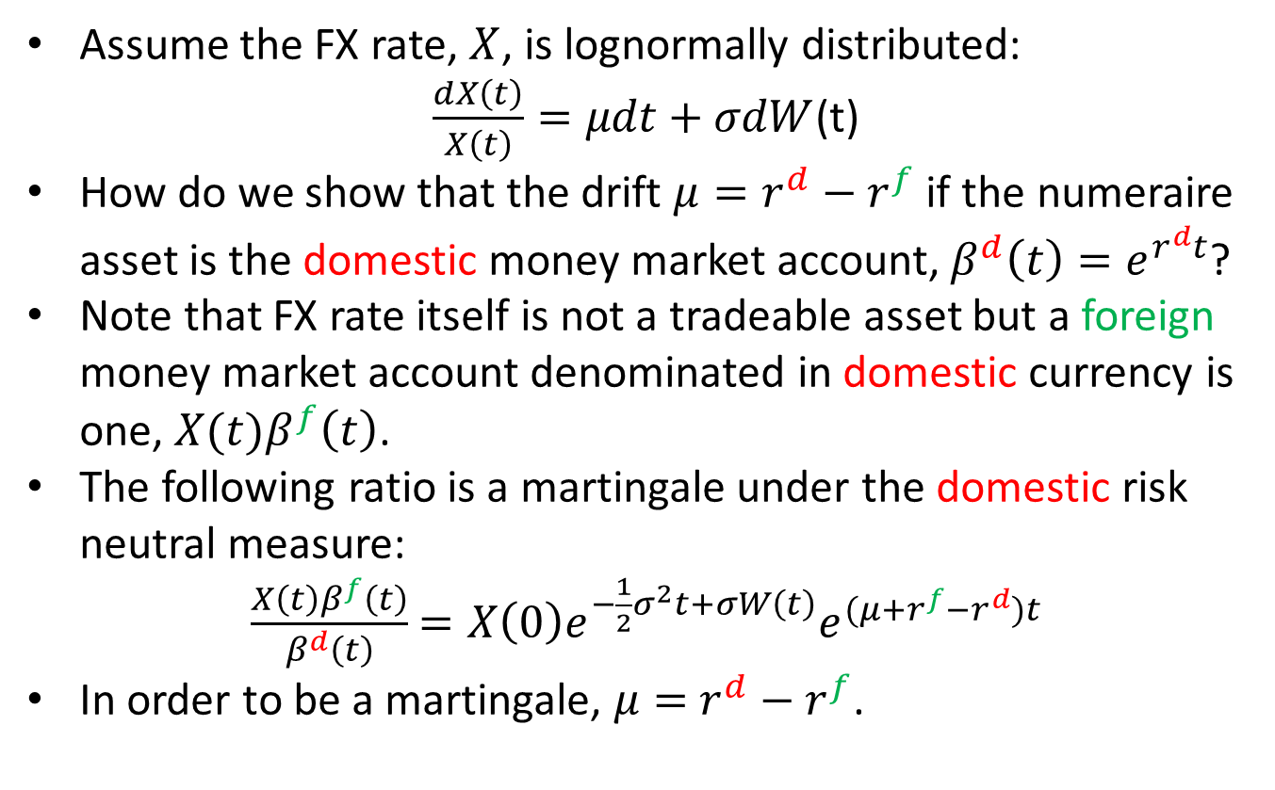
FX – domestic risk neutral measure
Assume the FX rate, $X$, is lognormally distributed:
$\frac{dX\left(t\right)}{X\left(t\right)}=μdt+σdW$(t)
How do we show that the drift $μ=r^{d}−r^{f}$ if the numeraire asset is the domestic money market account, $β^{d}\left(t\right)=e^{r^{d}t}$?
Note that FX rate itself is not a tradeable asset but a foreign money market account denominated in domestic currency is one, ${X(t)β}^{f}\left(t\right)$.
The following ratio is a martingale under the domestic risk neutral measure:
$\frac{{X\left(t\right)β}^{f}\left(t\right)}{β^{d}\left(t\right)}$ $=X\left(0\right)e^{−\frac{1}{2}σ^{2}t+σW\left(t\right)}e^{{(μ+r^{f}−r}^{d})t}$
In order to be a martingale, $μ=$ $r^{d}−r^{f}$.

Slide 10
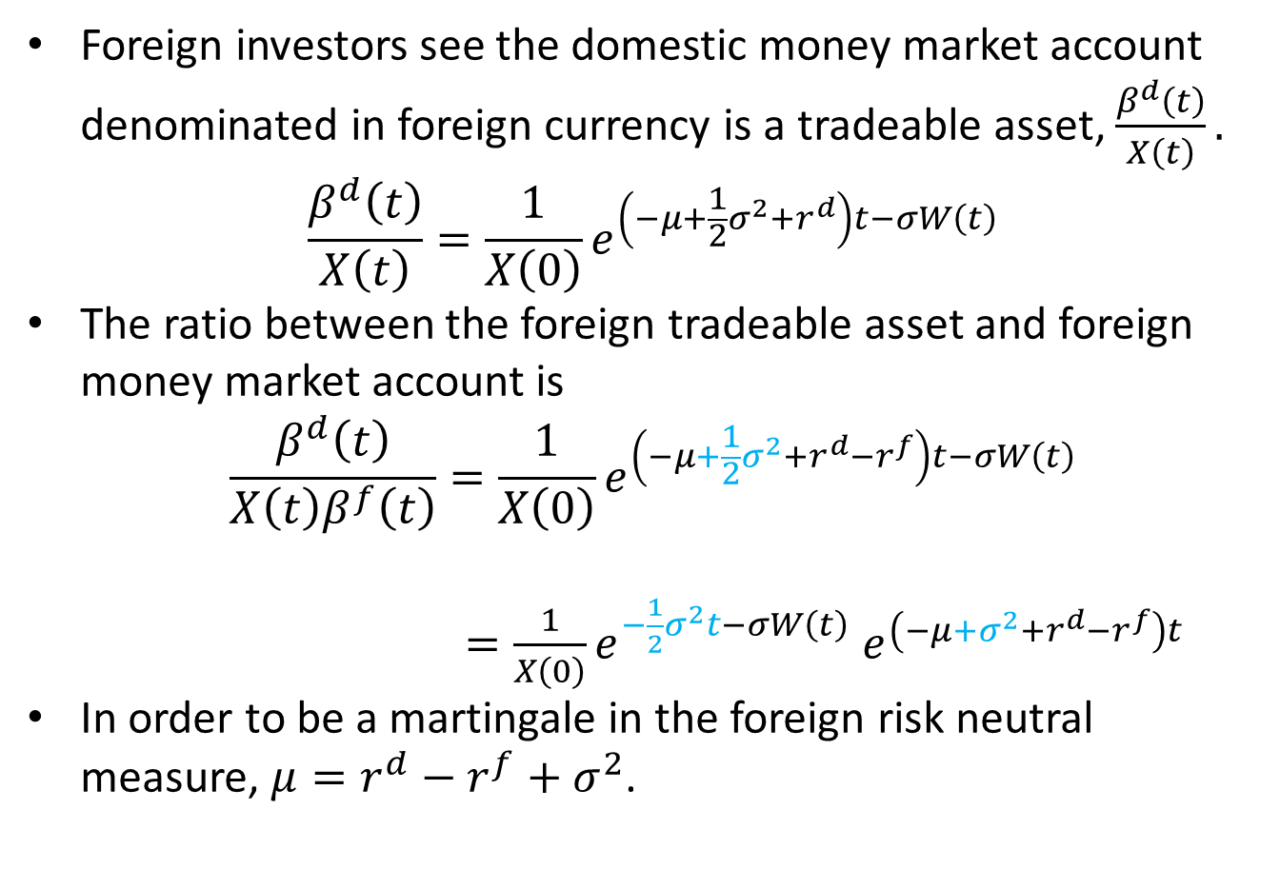
FX – foreign risk neutral measure
Foreign investors see the domestic money market account denominated in foreign currency is a tradeable asset, $\frac{β^{d}\left(t\right)}{X\left(t\right)}.$
$$\frac{β^{d}\left(t\right)}{X\left(t\right)}=\frac{1}{X\left(0\right)}e^{\left(−μ+\frac{1}{2}σ^{2}+r^{d}\right)t−σW\left(t\right)}$$
The ratio between the foreign tradeable asset and foreign money market account is
$$\frac{β^{d}\left(t\right)}{X\left(t\right)β^{f}\left(t\right)}=\frac{1}{X\left(0\right)}e^{\left(−μ+\frac{1}{2}σ^{2}+r^{d}−r^{f}\right)t−σW\left(t\right)}$$
$=\frac{1}{X\left(0\right)}e^{−\frac{1}{2}σ^{2}t−σW\left(t\right)}$ $e^{\left(−μ+σ^{2}+r^{d}−r^{f}\right)t}$
In order to be a martingale in the foreign risk neutral measure, $μ=r^{d}−r^{f}+σ^{2}$.

Slide 11
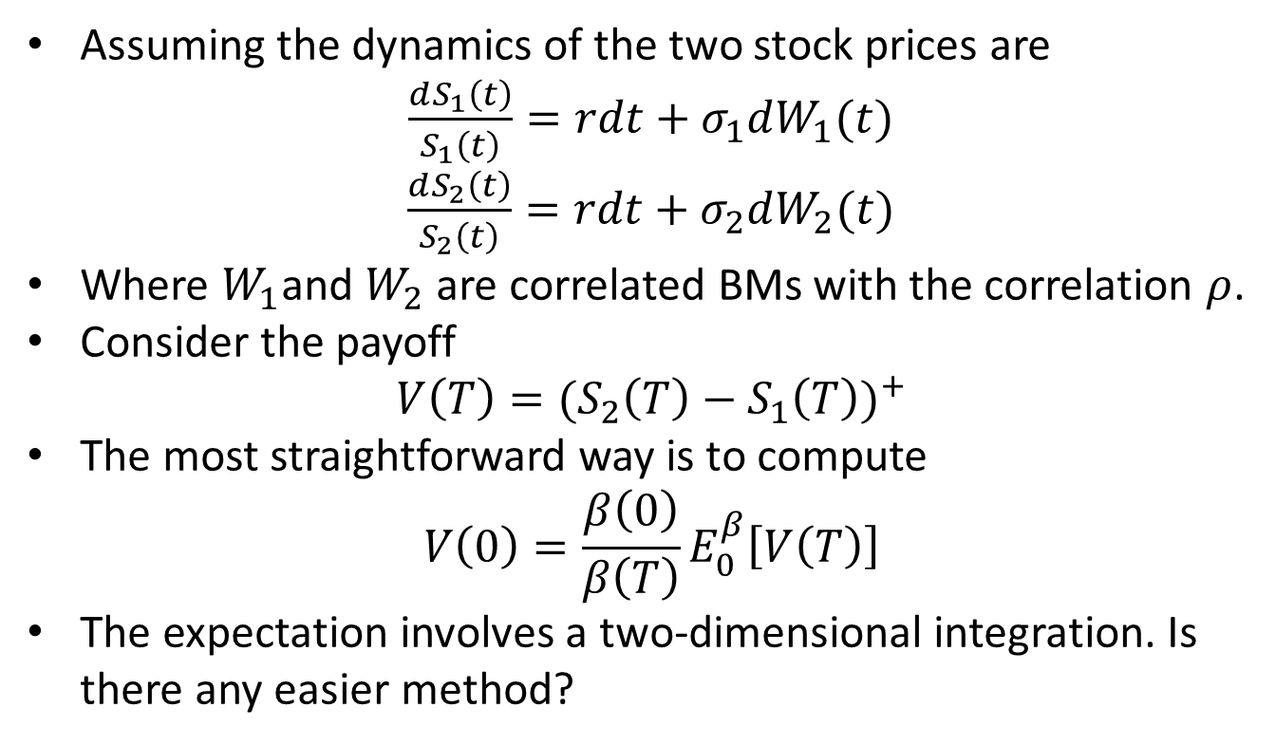
Margrabe Option Formula
Assuming the dynamics of the two stock prices are
$\frac{dS_{1}\left(t\right)}{S_{1}\left(t\right)}=rdt+σ_{1}dW_{1}(t)$
$\frac{dS_{2}\left(t\right)}{S_{2}\left(t\right)}=rdt+σ_{2}dW_{2}(t)$
Where $W_{1}$and $W_{2}$ are correlated BMs with the correlation $ρ$.
Consider the payoff
$$V\left(T\right)={{(S}_{2}\left(T\right)−S_{1}\left(T\right))}^{+}$$
The most straightforward way is to compute
$$V\left(0\right)=\frac{β\left(0\right)}{β\left(T\right)}E_{0}^{β}\left[V\left(T\right)\right]$$
The expectation involves a two-dimensional integration. Is there any easier method?

Slide 12
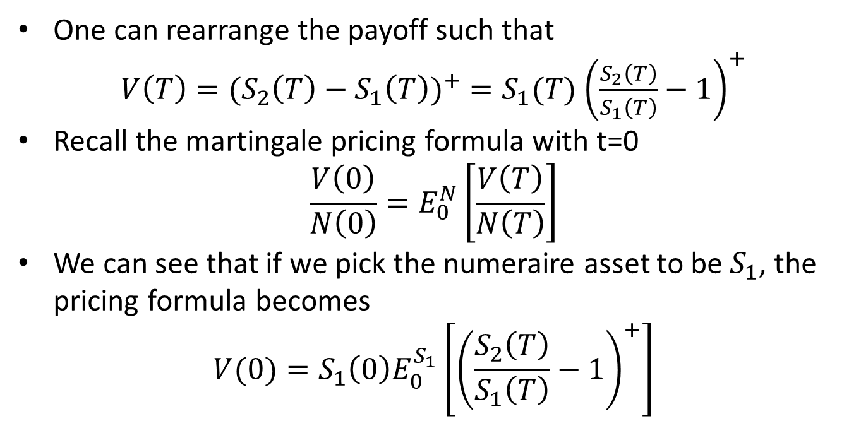
Margrabe Option Formula
One can rearrange the payoff such that
$V\left(T\right)={{(S}_{2}\left(T\right)−S_{1}\left(T\right))}^{+}=S_{1}(T)$ ${\left(\frac{S_{2}\left(T\right)}{S_{1}\left(T\right)}−1\right)}^{+}$
Recall the martingale pricing formula with t=0
$$\frac{V\left(0\right)}{N\left(0\right)}=E_{0}^{N}\left[\frac{V\left(T\right)}{N\left(T\right)}\right]$$
We can see that if we pick the numeraire asset to be $S_{1}$, the pricing formula becomes
$$V(0)={S_{1}\left(0\right)E}_{0}^{S_{1}}\left[{\left(\frac{S_{2}\left(T\right)}{S_{1}\left(T\right)}−1\right)}^{+}\right]$$

Slide 13
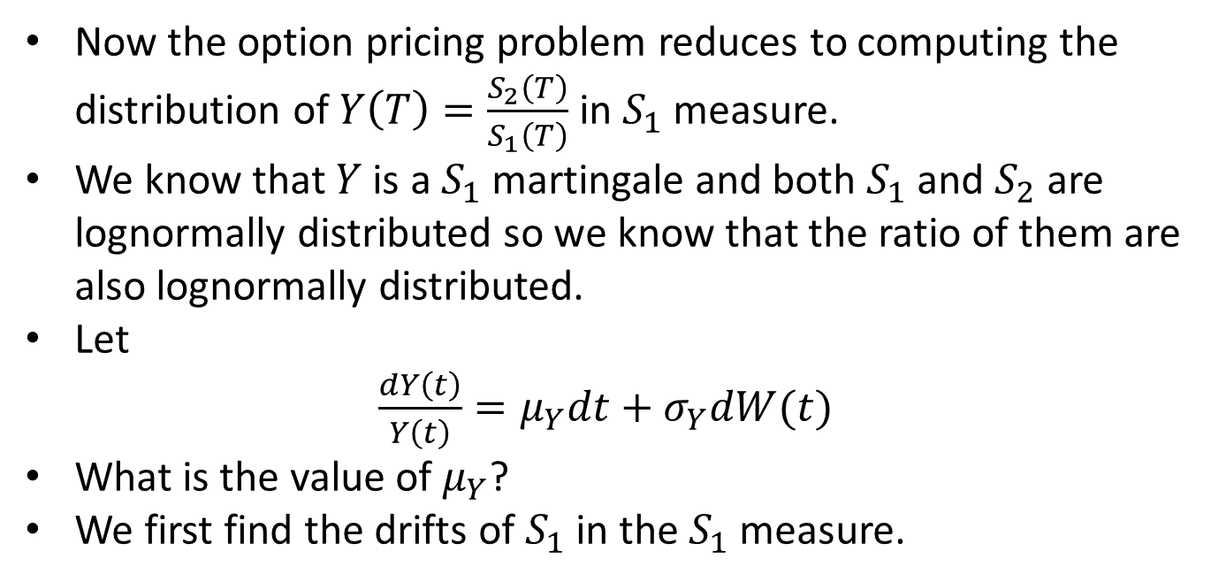
Margrabe Option Formula
Now the option pricing problem reduces to computing the distribution of$Y\left(T\right)=\frac{S_{2}\left(T\right)}{S_{1}\left(T\right)}$ in $S_{1}$ measure.
We know that $Y$ is a $S_{1}$ martingale and both $S_{1}$ and $S_{2}$ are lognormally distributed so we know that the ratio of them are also lognormally distributed.
Let
$\frac{dY\left(t\right)}{Y\left(t\right)}=μ_{Y}dt+σ_{Y}dW(t)$
What is the value of $μ_{Y}$?
We first find the drifts of $S_{1}$ in the $S_{1}$ measure.

Slide 14
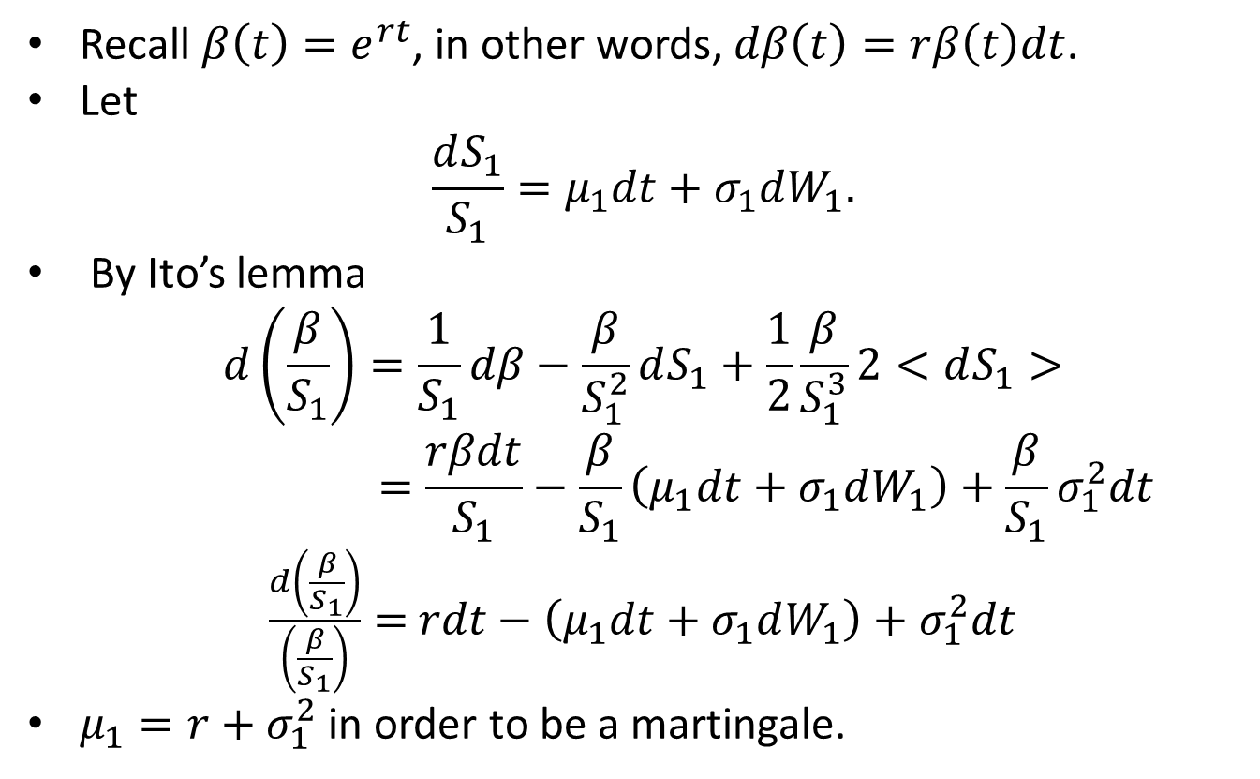
Margrabe Option Formula
Recall $β\left(t\right)=e^{rt}$, in other words, $dβ\left(t\right)=rβ\left(t\right)dt$.
Let
$$\frac{dS_{1}}{S_{1}}=μ_{1}dt+σ_{1}dW_{1}.$$
By Ito’s lemma
$$d\left(\frac{β}{S_{1}}\right)=\frac{1}{S_{1}}dβ−\frac{β}{S_{1}^{2}}dS_{1}+\frac{1}{2}\frac{β}{S_{1}^{3}}2<dS_{1}>$$
$$=\frac{rβdt}{S_{1}}−\frac{β}{S_{1}}\left(μ_{1}dt+σ_{1}dW_{1}\right)+\frac{β}{S_{1}}σ_{1}^{2}dt$$
$\frac{d\left(\frac{β}{S_{1}}\right)}{\left(\frac{β}{S_{1}}\right)}=$ $rdt−\left(μ_{1}dt+σ_{1}dW_{1}\right)+σ_{1}^{2}dt$
$μ_{1}=r+σ_{1}^{2}$ in order to be a martingale.

Slide 15
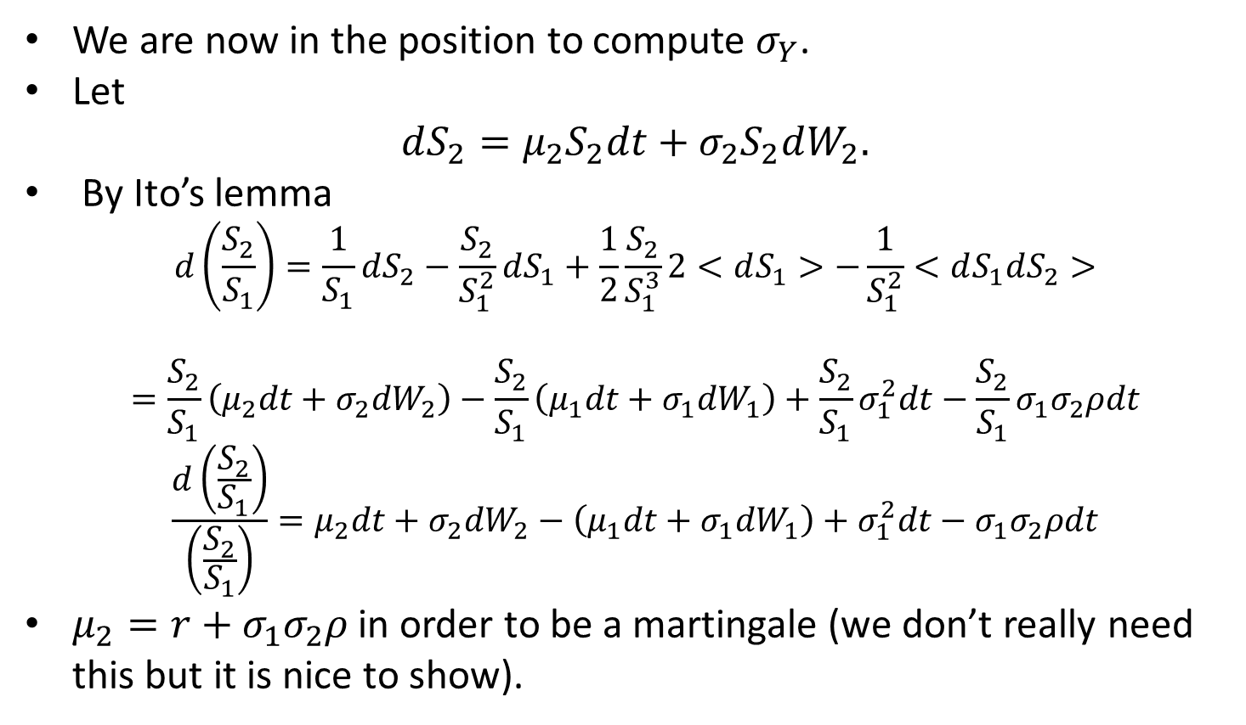
Margrabe Option Formula
We are now in the position to compute $σ_{Y}$.
Let
$$dS_{2}=μ_{2}S_{2}dt+σ_{2}S_{2}dW_{2}.$$
By Ito’s lemma
$$d\left(\frac{S_{2}}{S_{1}}\right)=\frac{1}{S_{1}}dS_{2}−\frac{S_{2}}{S_{1}^{2}}dS_{1}+\frac{1}{2}\frac{S_{2}}{S_{1}^{3}}2<dS_{1}>−\frac{1}{S_{1}^{2}}<dS_{1}dS_{2}>$$
$$=\frac{S_{2}}{S_{1}}\left(μ_{2}dt+σ_{2}dW_{2}\right)−\frac{S_{2}}{S_{1}}\left(μ_{1}dt+σ_{1}dW_{1}\right)+\frac{S_{2}}{S_{1}}σ_{1}^{2}dt−\frac{S_{2}}{S_{1}}σ_{1}σ_{2}ρdt$$
$$\frac{d\left(\frac{S_{2}}{S_{1}}\right)}{\left(\frac{S_{2}}{S_{1}}\right)}=μ_{2}dt+σ_{2}dW_{2}−\left(μ_{1}dt+σ_{1}dW_{1}\right)+σ_{1}^{2}dt−σ_{1}σ_{2}ρdt$$
$μ_{2}=r+σ_{1}σ_{2}ρ$ in order to be a martingale (we don’t really need this but it is nice to show).

Slide 16
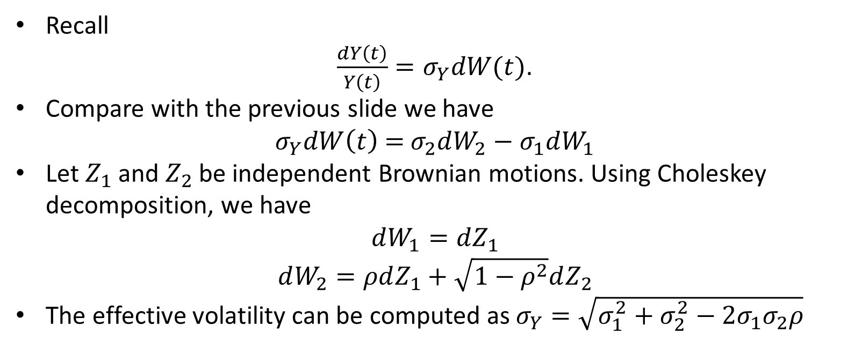
Margrabe Option Formula
Recall
$\frac{dY\left(t\right)}{Y\left(t\right)}=σ_{Y}dW(t)$.
Compare with the previous slide we have
$$σ_{Y}dW\left(t\right)\text{ = }σ_{2}dW_{2}−σ_{1}dW_{1}$$
Let $Z_{1}$ and $Z_{2}$ be independent Brownian motions. Using Choleskey decomposition, we have
$$dW_{1}=dZ_{1}$$
$$dW_{2}=ρdZ_{1}+\sqrt{1−ρ^{2}}dZ_{2}$$
The effective volatility can be computed as $σ_{Y}=\sqrt{σ_{1}^{2}+σ_{2}^{2}−2σ_{1}σ_{2}ρ}$

Slide 17
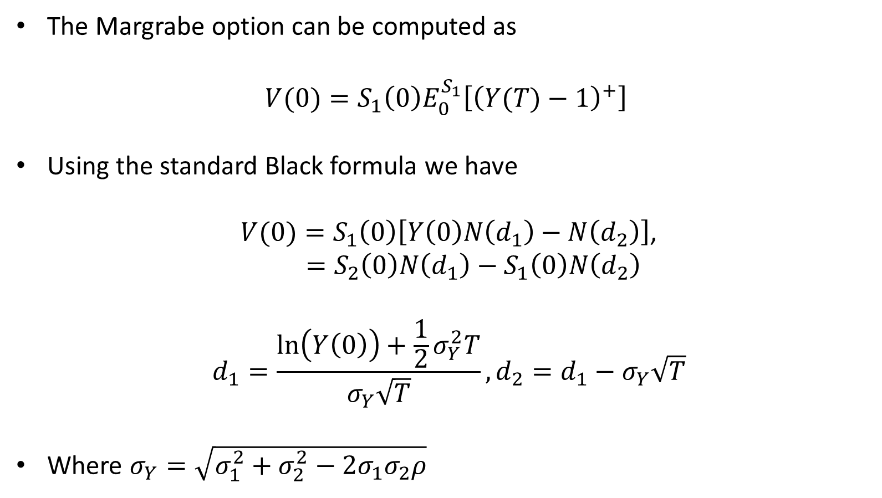
Margrabe Option Formula
The Margrabe option can be computed as
$$V(0)={S_{1}\left(0\right)E}_{0}^{S_{1}}\left[{\left(Y(T)−1\right)}^{+}\right]$$
Using the standard Black formula we have
$V(0)=S_{1}\left(0\right)\left[Y\left(0\right)N\left(d_{1}\right)−N\left(d_{2}\right)\right]$,
$$=S_{2}\left(0\right)N\left(d_{1}\right)−S_{1}\left(0\right)N\left(d_{2}\right)$$
$$d_{1}=\frac{\ln\left(Y\left(0\right)\right)+\frac{1}{2}σ_{Y}^{2}T}{σ_{Y}\sqrt{T}},d_{2}=d_{1}−σ_{Y}\sqrt{T}$$
Where $σ_{Y}=\sqrt{σ_{1}^{2}+σ_{2}^{2}−2σ_{1}σ_{2}ρ}$

Slide 18
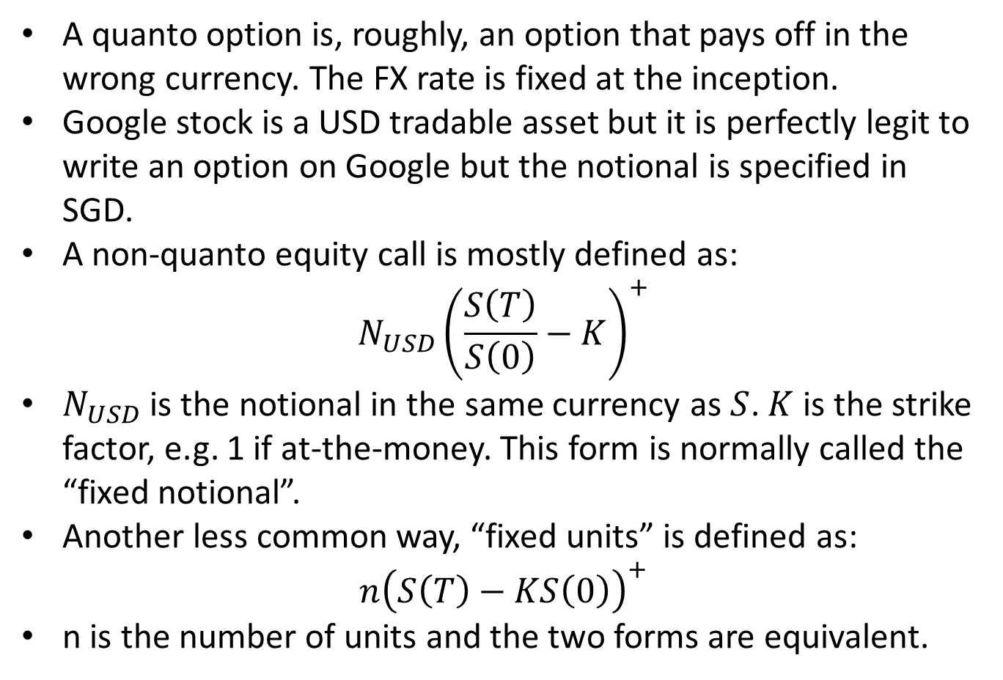
Quanto Option
A quanto option is, roughly, an option that pays off in the wrong currency. The FX rate is fixed at the inception.
Google stock is a USD tradable asset but it is perfectly legit to write an option on Google but the notional is specified in SGD.
A non-quanto equity call is mostly defined as:
$$N_{USD}{\left(\frac{S\left(T\right)}{S\left(0\right)}−K\right)}^{+}$$
$N_{USD}$ is the notional in the same currency as $S$. $K$ is the strike factor, e.g. 1 if at-the-money. This form is normally called the “fixed notional”.
Another less common way, “fixed units” is defined as:
$$n{\left(S\left(T\right)−KS\left(0\right)\right)}^{+}$$
n is the number of units and the two forms are equivalent.

Slide 19
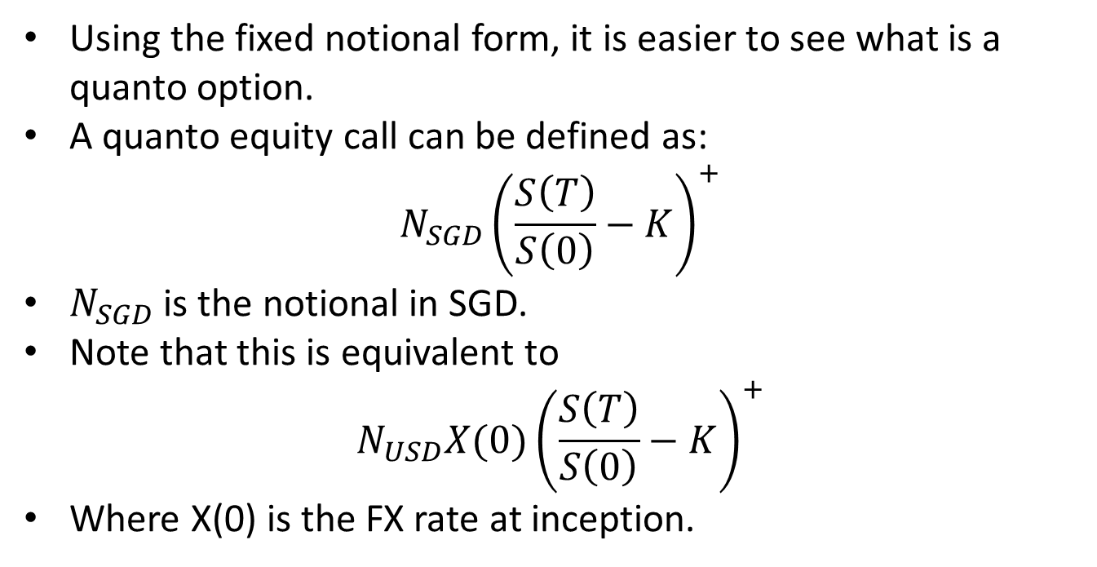
Quanto Option
Using the fixed notional form, it is easier to see what is a quanto option.
A quanto equity call can be defined as:
$$N_{SGD}{\left(\frac{S\left(T\right)}{S\left(0\right)}−K\right)}^{+}$$
$N_{SGD}$ is the notional in SGD.
Note that this is equivalent to
$$N_{USD}X(0){\left(\frac{S\left(T\right)}{S\left(0\right)}−K\right)}^{+}$$
Where X(0) is the FX rate at inception.

Slide 20
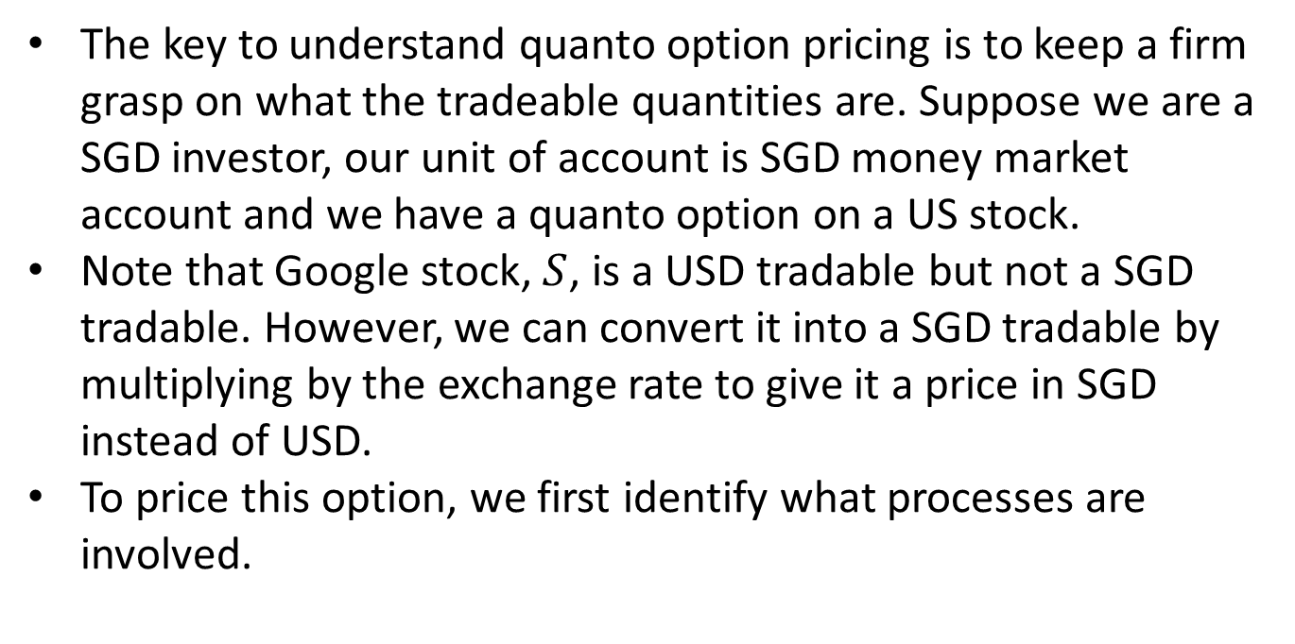
Quanto Option
The key to understand quanto option pricing is to keep a firm grasp on what the tradeable quantities are. Suppose we are a SGD investor, our unit of account is SGD money market account and we have a quanto option on a US stock.
Note that Google stock, $S$, is a USD tradable but not a SGD tradable. However, we can convert it into a SGD tradable by multiplying by the exchange rate to give it a price in SGD instead of USD.
To price this option, we first identify what processes are involved.

Slide 21
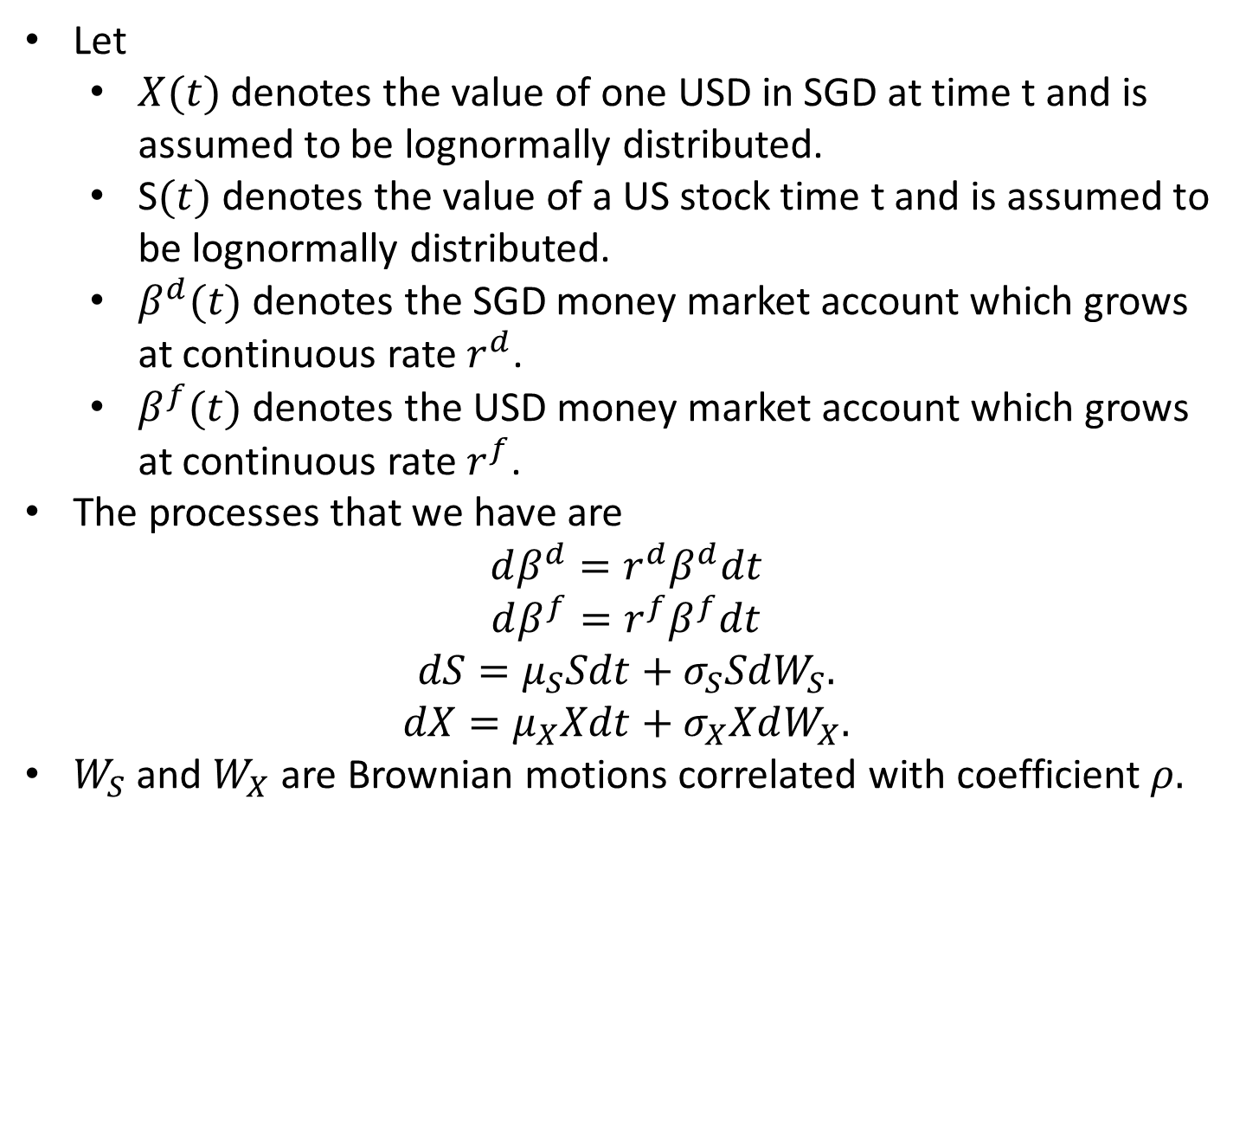
Quanto Option
Let
$X(t)$ denotes the value of one USD in SGD at time t and is assumed to be lognormally distributed.
S$(t)$ denotes the value of a US stock time t and is assumed to be lognormally distributed.
$β^{d}(t)$ denotes the SGD money market account which grows at continuous rate $r^{d}$.
$β^{f}(t)$ denotes the USD money market account which grows at continuous rate $r^{f}$.
The processes that we have are
$$dβ^{d}=r^{d}β^{d}dt$$
$$dβ^{f}=r^{f}β^{f}dt$$
$$dS=μ_{S}Sdt+σ_{S}SdW_{S}.$$
$$dX=μ_{X}Xdt+σ_{X}XdW_{X}.$$
$W_{S}$ and $W_{X}$ are Brownian motions correlated with coefficient $ρ.$

Slide 22
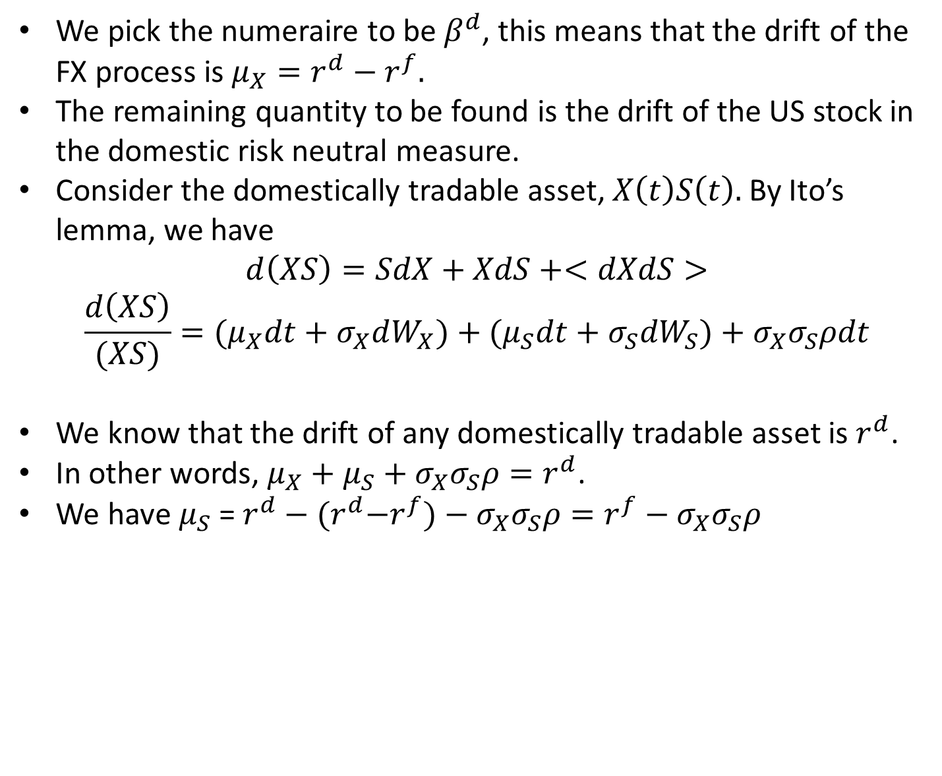
Quanto Option
We pick the numeraire to be $β^{d}$, this means that the drift of the FX process is $μ_{X}=r^{d}−r^{f}.$
The remaining quantity to be found is the drift of the US stock in the domestic risk neutral measure.
Consider the domestically tradable asset, $X\left(t\right)S\left(t\right).$ By Ito’s lemma, we have
$$d\left(XS\right)=SdX+XdS+<dXdS>$$
$$\frac{d\left(XS\right)}{(XS)}={(μ}_{X}dt+σ_{X}dW_{X})+{(μ}_{S}dt+σ_{S}dW_{S})+σ_{X}σ_{S}ρdt$$
We know that the drift of any domestically tradable asset is $r^{d}$.
In other words, $μ_{X}+μ_{S}+σ_{X}σ_{S}ρ=r^{d}$.
We have $μ_{S}$ = $r^{d}−{(r}^{d}−r^{f})−σ_{X}σ_{S}ρ=r^{f}−σ_{X}σ_{S}ρ$

Slide 23
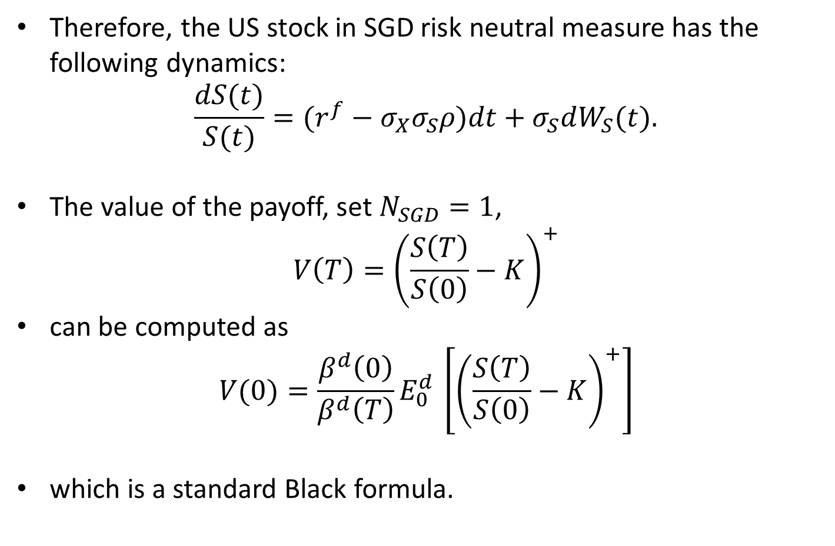
Quanto Option
Therefore, the US stock in SGD risk neutral measure has the following dynamics:
$$\frac{dS(t)}{S(t)}=(r^{f}−σ_{X}σ_{S}ρ)dt+σ_{S}dW_{S}(t).$$
The value of the payoff, set $N_{SGD}=1$,
$$V\left(T\right)={\left(\frac{S\left(T\right)}{S\left(0\right)}−K\right)}^{+}$$
can be computed as
$$V(0)={\frac{β^{d}\left(0\right)}{β^{d}\left(T\right)}E}_{0}^{d }\left[{\left(\frac{S\left(T\right)}{S\left(0\right)}−K\right)}^{+}\right]$$
which is a standard Black formula.

Slide 24
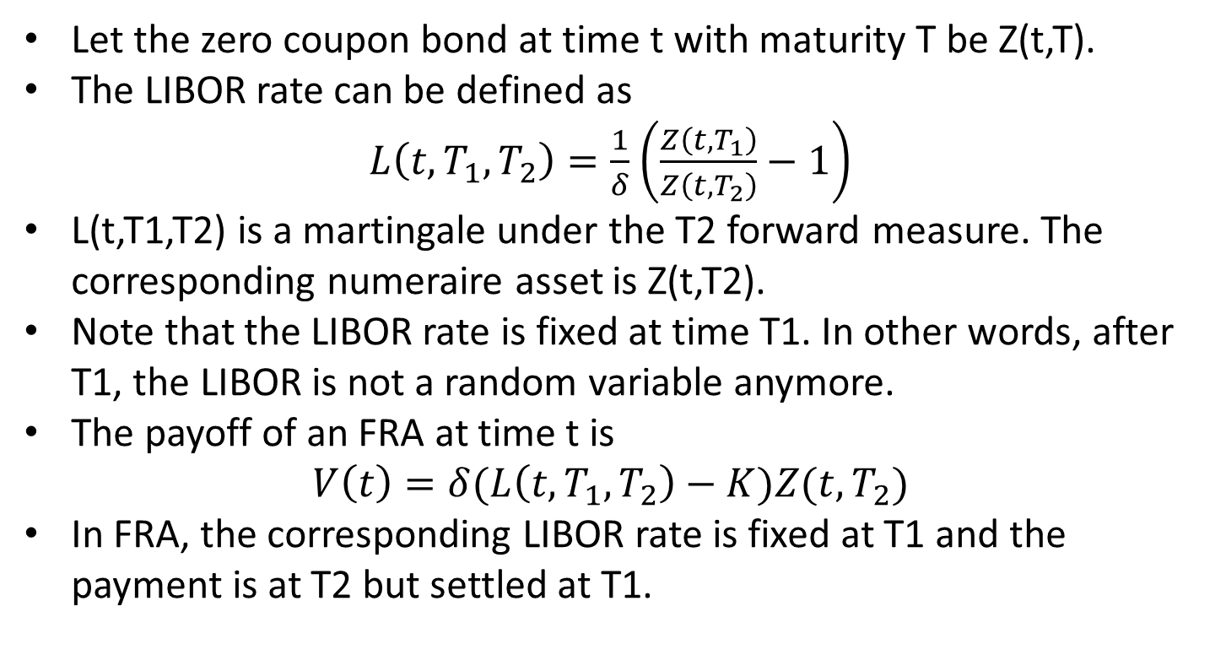
LIBOR in arrears
Let the zero coupon bond at time t with maturity T be Z(t,T).
The LIBOR rate can be defined as
$L\left(t,T_{1},T_{2}\right)=\frac{1}{δ}$ $\left(\frac{Z\left(t,T_{1}\right)}{Z\left(t,T_{2}\right)}−1\right)$
L(t,T1,T2) is a martingale under the T2 forward measure. The corresponding numeraire asset is Z(t,T2).
Note that the LIBOR rate is fixed at time T1. In other words, after T1, the LIBOR is not a random variable anymore.
The payoff of an FRA at time t is
$$V\left(t\right)=δ(L\left(t,T_{1},T_{2}\right)−K)Z(t,T_{2})$$
In FRA, the corresponding LIBOR rate is fixed at T1 and the payment is at T2 but settled at T1.

Slide 25
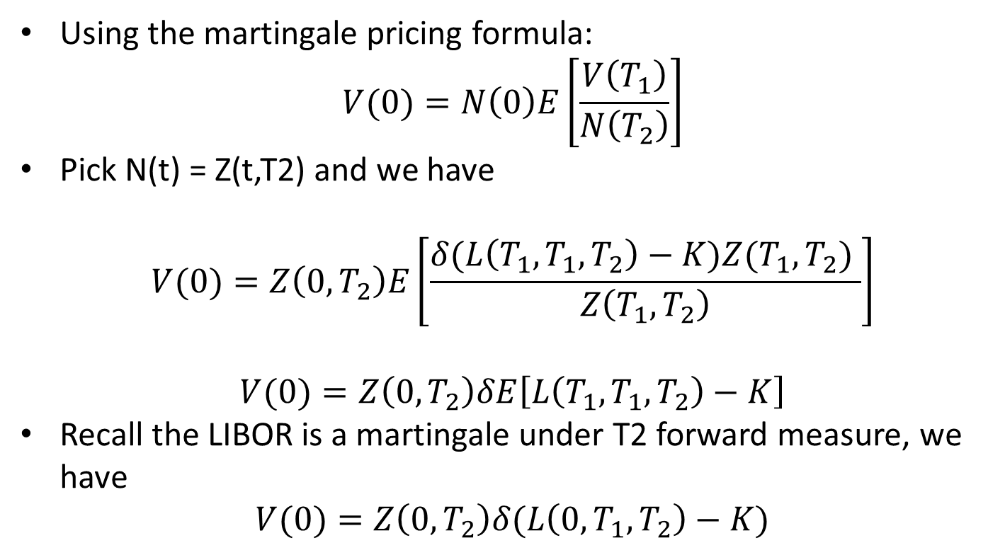
LIBOR in arrears
Using the martingale pricing formula:
$$V(0)=N\left(0\right)E\left[\frac{V\left(T_{1}\right)}{N\left(T_{2}\right)}\right]$$
Pick N(t) = Z(t,T2) and we have
$$V(0)=Z\left(0,T_{2}\right)E\left[\frac{δ(L\left(T_{1},T_{1},T_{2}\right)−K)Z(T_{1},T_{2}) }{Z\left(T_{1},T_{2}\right)}\right]$$
$$V(0)=Z\left(0,T_{2}\right)δE\left[L\left(T_{1},T_{1},T_{2}\right)−K\right]$$
Recall the LIBOR is a martingale under T2 forward measure, we have
$$V(0)=Z\left(0,T_{2}\right)δ(L\left(0,T_{1},T_{2}\right)−K)$$

Slide 26
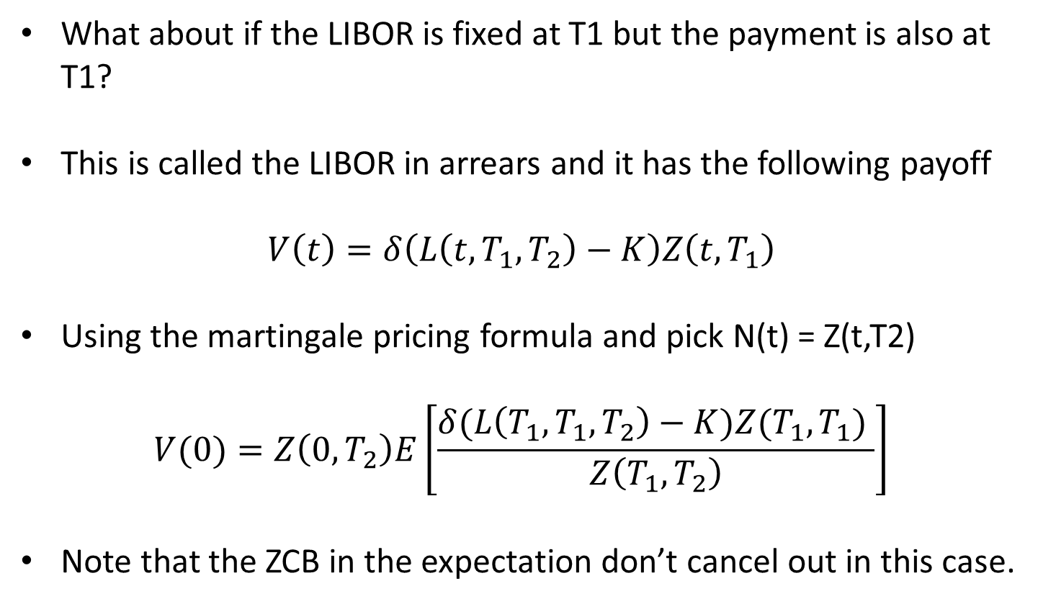
LIBOR in arrears
What about if the LIBOR is fixed at T1 but the payment is also at T1?
This is called the LIBOR in arrears and it has the following payoff
$$V\left(t\right)=δ\left(L\left(t,T_{1},T_{2}\right)−K\right)Z\left(t,T_{1}\right)$$
Using the martingale pricing formula and pick N(t) = Z(t,T2)
$$V(0)=Z\left(0,T_{2}\right)E\left[\frac{δ(L\left(T_{1},T_{1},T_{2}\right)−K)Z(T_{1},T_{1}) }{Z\left(T_{1},T_{2}\right)}\right]$$
Note that the ZCB in the expectation don’t cancel out in this case.

Slide 27
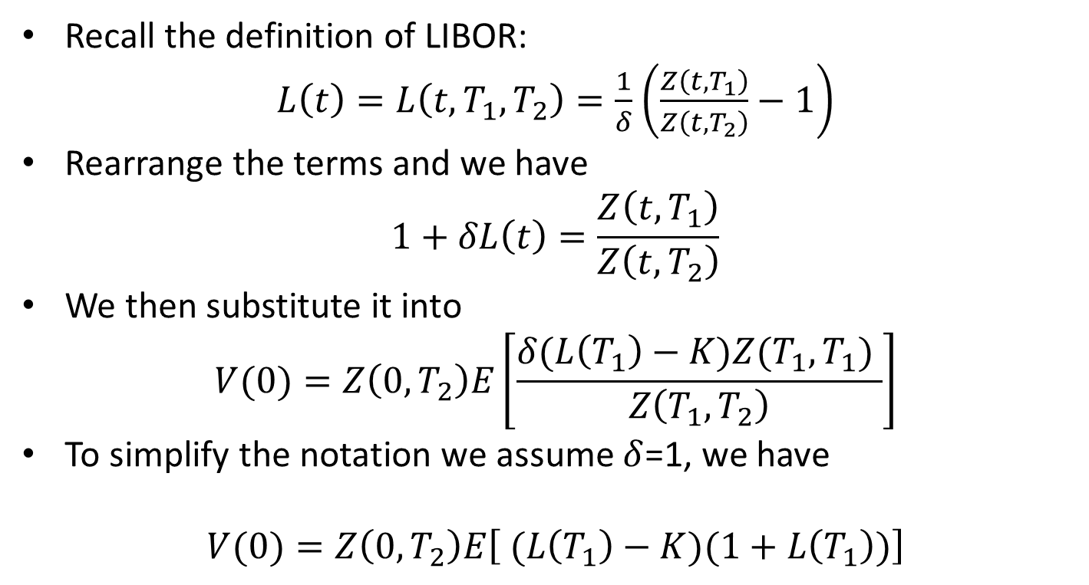
LIBOR in arrears
Recall the definition of LIBOR:
$L\left(t\right)=L\left(t,T_{1},T_{2}\right)=\frac{1}{δ}$ $\left(\frac{Z\left(t,T_{1}\right)}{Z\left(t,T_{2}\right)}−1\right)$
Rearrange the terms and we have
$$1+δL\left(t\right)=\frac{Z\left(t,T_{1}\right)}{Z\left(t,T_{2}\right)}$$
We then substitute it into
$$V(0)=Z\left(0,T_{2}\right)E\left[\frac{δ(L\left(T_{1}\right)−K)Z(T_{1},T_{1}) }{Z\left(T_{1},T_{2}\right)}\right]$$
To simplify the notation we assume $δ$=1, we have
$$V(0)=Z\left(0,T_{2}\right)E\left[ (L\left(T_{1}\right)−K)(1+L\left(T_{1}\right))\right]$$

Slide 28
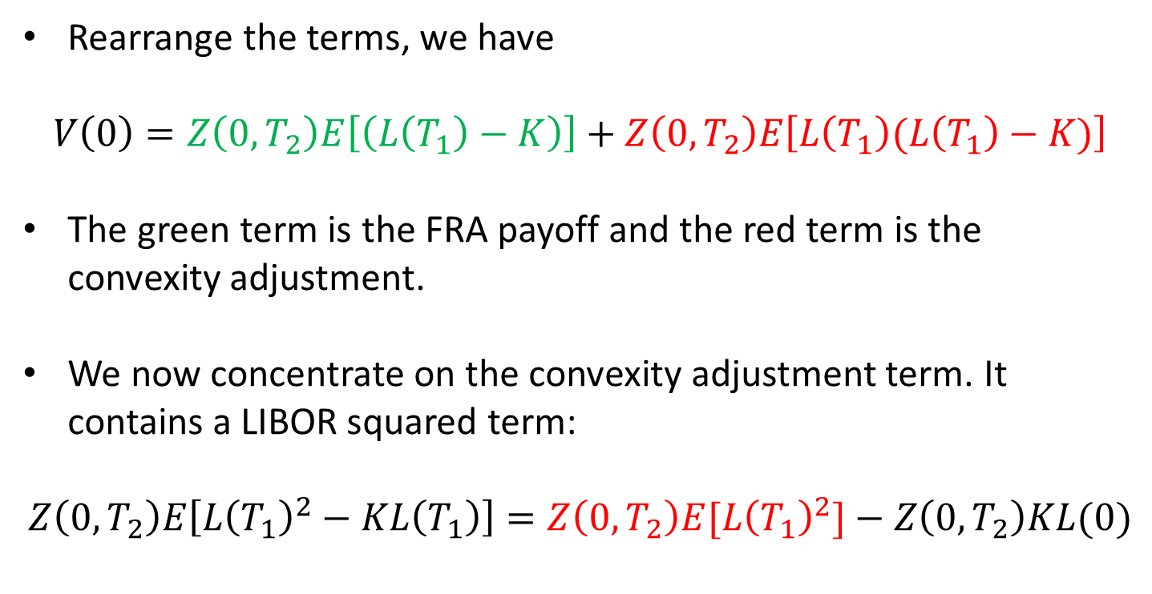
LIBOR in arrears
Rearrange the terms, we have
$$V\left(0\right)=Z\left(0,T_{2}\right)E\left[\left(L\left(T_{1}\right)−K\right)\right]+Z\left(0,T_{2}\right)E\left[L\left(T_{1}\right)(L\left(T_{1}\right)−K)\right]$$
The green term is the FRA payoff and the red term is the convexity adjustment.
We now concentrate on the convexity adjustment term. It contains a LIBOR squared term:
$$Z\left(0,T_{2}\right)E\left[L{\left(T_{1}\right)}^{2}−KL\left(T_{1}\right)\right]=Z\left(0,T_{2}\right)E[L{\left(T_{1}\right)}^{2}]−Z\left(0,T_{2}\right)KL(0)$$

Slide 29
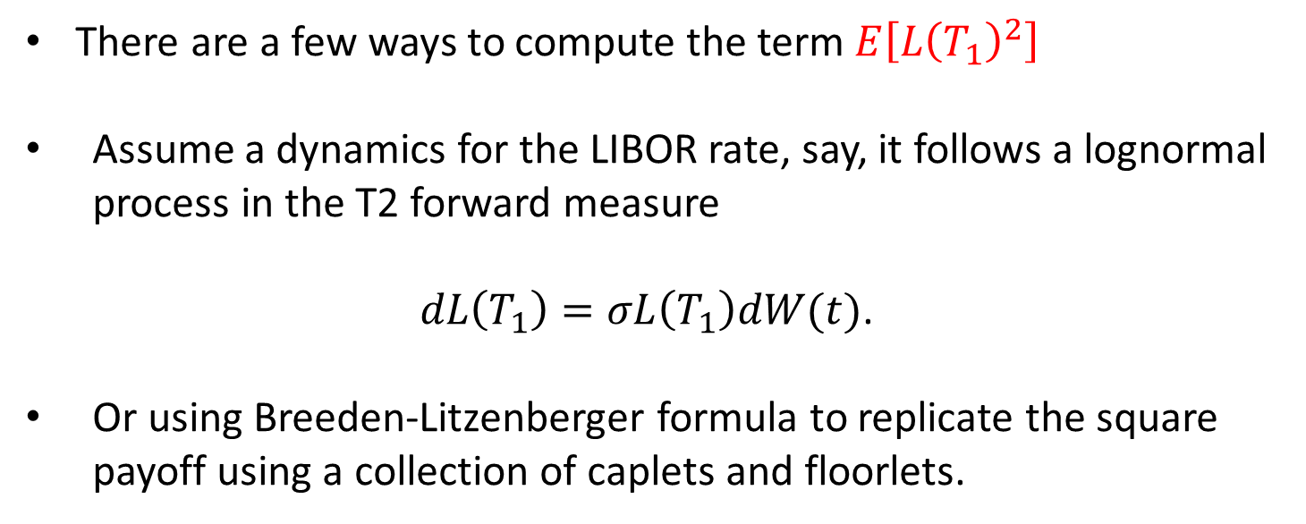
LIBOR in arrears
There are a few ways to compute the term$E\left[L{\left(T_{1}\right)}^{2}\right]$
Assume a dynamics for the LIBOR rate, say, it follows a lognormal process in the T2 forward measure
$dL\left(T_{1}\right)=σL\left(T_{1}\right)dW(t)$.
Or using Breeden-Litzenberger formula to replicate the square payoff using a collection of caplets and floorlets.

